Slide 1

Tweety

Slide 2
PART
1
The Approach

Slide 3
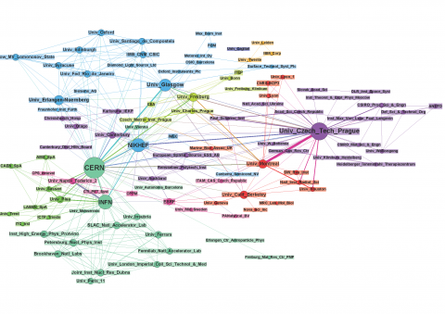
1
The Objectives
Measure the Influence of a Twitter User
Choose an Influencer for our Message

Slide 4
1
Two Approaches
One model for all the influencers
One model for each influencers
New
Tweet
Influencer 1
Influencer 2
Influencer 3
# Retweets?
# Retweets?
# Retweets?

Slide 5

PART
2
Assumptions and Factors Considered

Slide 6

2
Assumptions
The tweet’s content will affect its effectiveness
Influencer’s reach changes over time
Linearity between factors and response variable
Influence $≅$ #retweets
Notes:
1. If an influencer has had many retweets in the past, then we can assume that his future tweets wil have more retweets.
2. According to [3], users who focus their tweets on a single topic are more likely to gain more influence.
3. The tweets of someone with more active followers are more likely to be retweeted.
4. The influencer should be influential in the tweet’s field.
5. Tweets with different type of media will have different level of popularity.
6. The time between the last retweet and the original tweet. It measures how long a tweet is in circulation.
7. The average time between the original tweet and each of its retweets. This measures how quickly it spreads.
8. More capital letters might suggest that the message the user is trying to convey is more exciting or more important.
9. A user who frequently posts popular topics may be more influential.
10. A user who uses simpler or shorter words are more likely to be more influential.

Slide 7
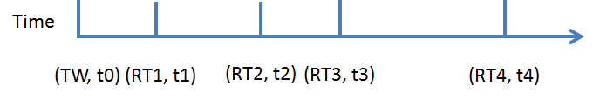
2
Message Factors
Number of Hashtags
Media
Fraction of Capital Letters
Fraction of Words Relating to Popular Topics
Average Word Length
Influencer Factors
Moving Summation of #Retweets
#Interactions (Retweets and mentions)
Duration
Average Retweet Time
Notes:
1. If an influencer has had many retweets in the past, then we can assume that his future tweets wil have more retweets.
2. According to [3], users who focus their tweets on a single topic are more likely to gain more influence.
3. The tweets of someone with more active followers are more likely to be retweeted.
4. The influencer should be influential in the tweet’s field.
5. Tweets with different type of media will have different level of popularity.
6. The time between the last retweet and the original tweet. It measures how long a tweet is in circulation.
7. The average time between the original tweet and each of its retweets. This measures how quickly it spreads.
8. More capital letters might suggest that the message the user is trying to convey is more exciting or more important.
9. A user who frequently posts popular topics may be more influential.
10. A user who uses simpler or shorter words are more likely to be more influential.

Slide 8

PART
3
Model

Slide 9
3
Twenty Regressions
$$y \sim {{(f}_{1}+ f_{2}+f_{3}+…+ f_{9})}^{7}$$
Notes:
Here we are using an example to explain the construction of our model.
Each user will have its own model.
Here we present a hypothetical user with 1000 tweets, labeled T₁ through T₁₀₀₀. These tweets are ordered based on their time stamps.
Our response variable Y_{N} will be the number of retweets of each tweet T_{N}.
The explanatory variable X_{N} will be a vector of the data relating to tweets T_{N-100} through T_{N-1} .
For example, the Y₁₀₀ is the number of retweets of T100. X₅₀₀ is the data about tweets T₄₀₀ through T₄₉₉.
Because our data consists of running averages, we will start with Y100 to avoid volatility in the running averages.
For each user, the first 10% of tweets will make up our first data point. The last data point for model construction will use the first 90% of tweets.
For our example here, that means our data consists of X₁₀₀ to X₉₀₀ . Using this data we will perform a linear regression to create the user’s model.

Slide 10
3
Data Structure for One Influencer
Assume an influencer has posted 1001 tweets.
Message Influencer
Factors Factors
T₀ X₀ N/A
… … …
T₁₀₀ X₁₀₀ m_sum(X₀ ~ X₉₉)
… … …
T₉₀₀ X₉₀₀ m_sum(X₈₀₀ ~ X₈₉₉)
… … …
T₁₀₀₀ X₁₀₀₀ m_sum(X₉₀₁ ~ X₁₀₀₀)
TIME
Notes:
Here we are using an example to explain the construction of our model.
Each user will have its own model.
Here we present a hypothetical user with 1000 tweets, labeled T₁ through T₁₀₀₀. These tweets are ordered based on their time stamps.
Our response variable Y_{N} will be the number of retweets of each tweet T_{N}.
The explanatory variable X_{N} will be a vector of the data relating to tweets T_{N-100} through T_{N-1} .
For example, the Y₁₀₀ is the number of retweets of T100. X₅₀₀ is the data about tweets T₄₀₀ through T₄₉₉.
Because our data consists of running averages, we will start with Y100 to avoid volatility in the running averages.
For each user, the first 10% of tweets will make up our first data point. The last data point for model construction will use the first 90% of tweets.
For our example here, that means our data consists of X₁₀₀ to X₉₀₀ . Using this data we will perform a linear regression to create the user’s model.

Slide 11
PART
4
Validation and Results

Slide 12

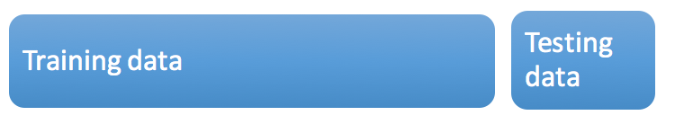


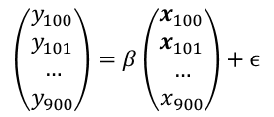
4
The predicted value
The true value
Calculate the mean square errors (MSE) to evaluate the model
点击此处添加标题
点击此处添加标题
Notes:
Once we have constructed a linear model for each user, we can use the last 10% of tweets for each user to test the models.
Continuing our previous example, we would use the X₉₀₁ through X₁₀₀₀ to create predicted values for₉₀₁ through ₁₀₀₀ . We then use our predicted and actual response values to calculate the mean square error.
Train the model based on T1-T900
Test the model’s predictive value on T901-T1000

Slide 15
PART
5
Summary

Slide 16
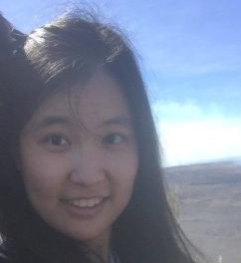
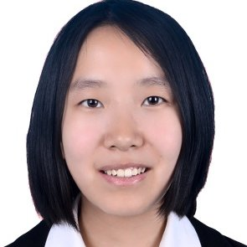
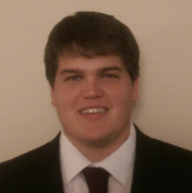

Tweety
THANK
YOU!
Michael Hardisty
Qiqi Ai
Fengze Cao
Quan Zhou
01
02
03
04
Leader
First Year
Statistics
Leader BFF
First Year
Statistics
Boss
First Year
QCF
Coding
Monkey
First Year
QCF

Slide 17
PART
6
Reference:

Slide 18
6
Reference:
Rosenman, Evan TR. “Retweets—but not just retweets: Quantifying and predicting influence on twitter. Diss. Bachelor’s thesis, applied mathematics.” Harvard College, Cambridge, 2012.
Willis, Alistair, Ali Fisher, and Ilia Lvov. "Mapping networks of influence: Tracking Twitter conversations through time and space." Participations: Journal of Audience & Reception Studies 12.1 (2015): 494-530.
Cha, Meeyoung, et al. "Measuring User Influence in Twitter: The Million Follower Fallacy." ICWSM 10.10-17 (2010): 30
Bakshy, Eytan, et al. "Everyone's an influencer: quantifying influence on twitter." Proceedings of the fourth ACM international conference on Web search and data mining. ACM, 2011.
Logo. Twitter, Inc.
点击此处添加标题
点击此处添加标题

Slide 19
7
Contact Information
Qiqi Ai. qai7@gatech.edu
Fengze Cao. fcao33@gatech.edu
Michael Hardisty. mhardisty@gatech.edu
Quan Zhou. qzhou90@gatech.edu
点击此处添加标题
点击此处添加标题

